Slide 1

THE GAME
“POKEMON”

Slide 2

Devopriya Tirtho
16-02-04-033
Rashedun Nobi Nirzhor
16-02-04-039

Slide 3

* Project Type: Computer Game
Used Software: Visual Studio 2010,2017
Project Name: Pokemon
Inspired By:Pokemon Anime

Slide 4

“Pokemon”
THE GAME
An Action and Adventure Based Game
Eye-catching interface
User Friendly Control System
Slight Use of Artificial Intelligence

Slide 5

BEHIND THE GAME
*Planning
*Usage of Visual Studio
*Implementation of Ideas
*Making Media Files
*Coding
*Execution

Slide 6

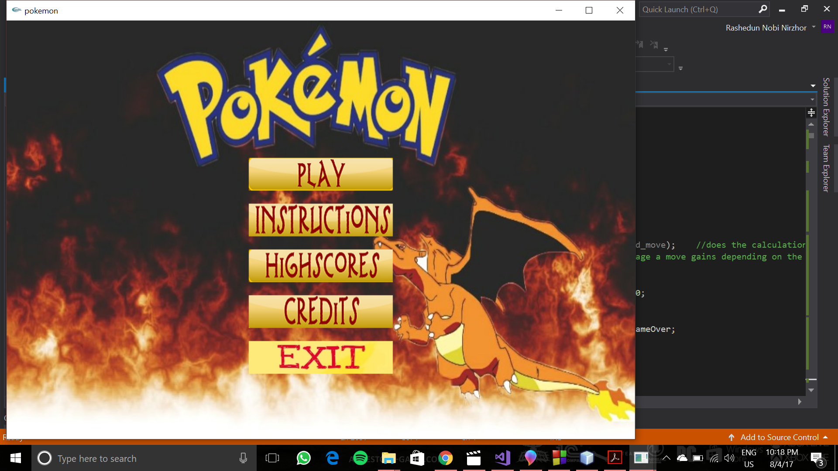
INTERFACE
*Very Attractive Interface……..

Slide 7

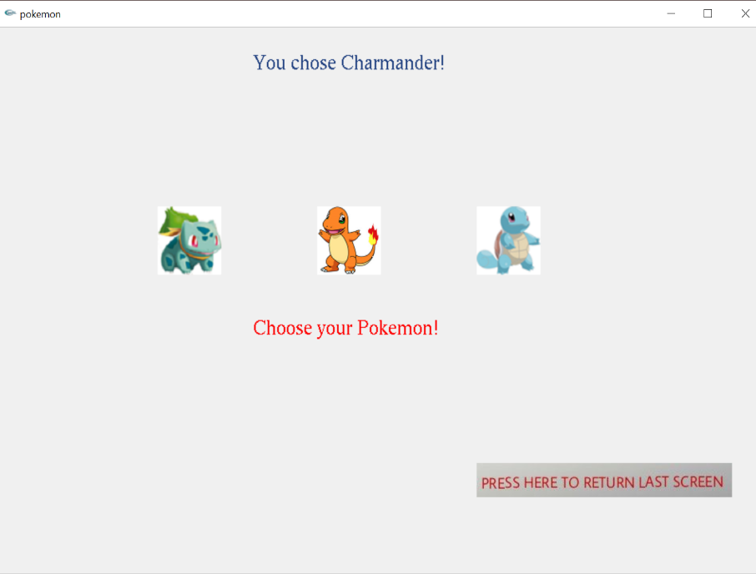
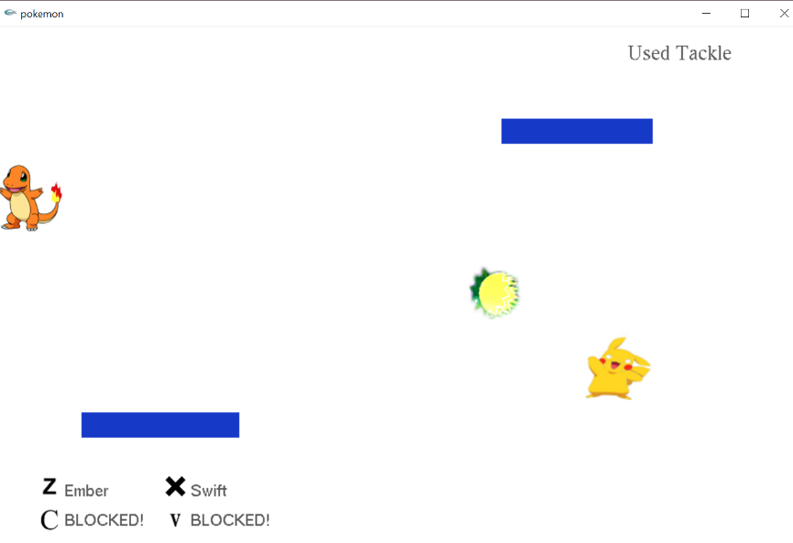
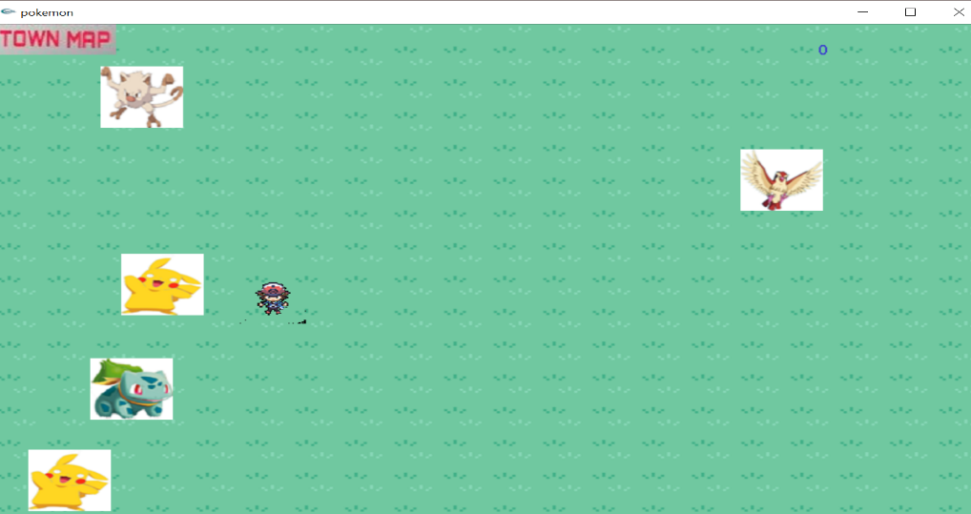
GAMEPLAY
Gameplay

Slide 8

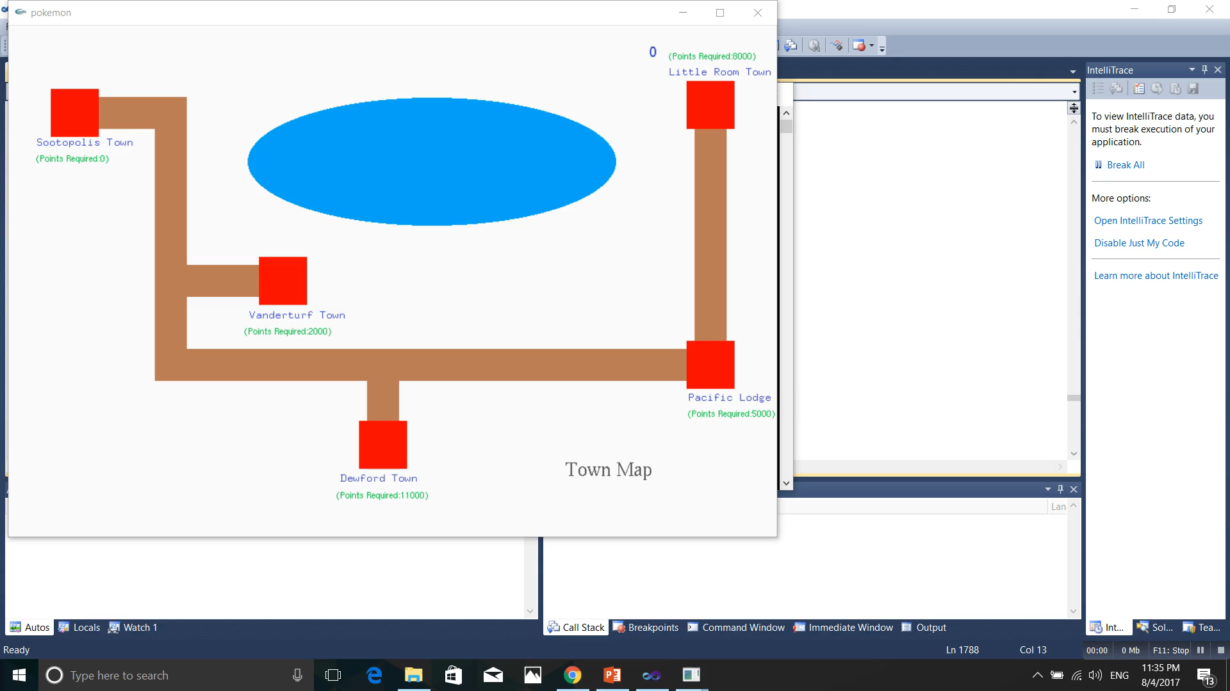
ARTIFICIALLY INTELLIGENT OPPONENT
Opponent will hit the user with it’s personal intelligence……

Slide 9




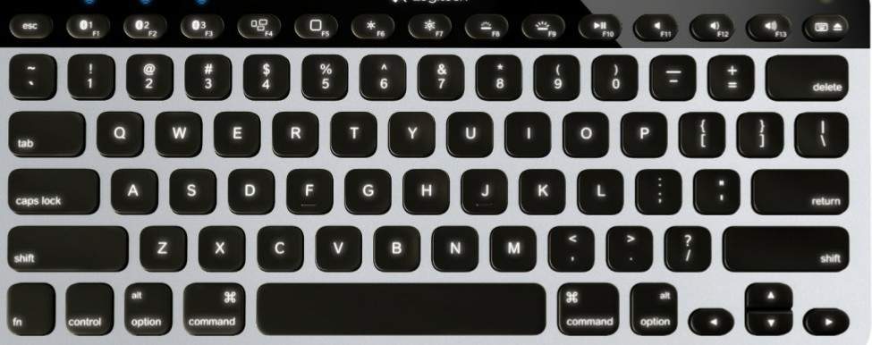



HOW TO CONTROL
FOR MOVEMENT
FOR ATTACK

Slide 10

WHY USER WILL PLAY THE GAME ???
*Thrilling Gameplay
*Addictive
*Various Types of Pokemons
*Not So Easy to Complete
*Opponents are not dumb,They will Hit You Back According to Your Position

Slide 11

Let’s Enjoy The Game “POKEMON”…….
T H A N K Y O U A L L

